Slide 1
Vocabulary
Red Hot Root Words
11-9-09

Slide 2
Root Words
Root Words Meaning Words You Already Know
fin end finish
sat enough satisfy
term end terminal
Notes:
Input:
Present the root words” Explain their meanings.
CFU:
Ask students to tell you another word with fore
Repeat with other root words.

Slide 3
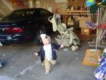
confine
verb
To keep within certain limits; to imprison
It was hard to confine the toddler to one area of the house.
Notes:
Input:
Present the word
State the part of speech
Read the definition and sentence
Point out the suffix on the word
Tell students to make sure they are familiar with how the word is used in the sentence
CFU:
Ask a student to give a paraphrase, example, or another sentence
Ask a different student to provide an example or another sentence using the word
Model:
If students are not able to do the CFU, provide a paraphrase and an example
Do this for any word that the students cannot paraphrase or give an example for.

Slide 4
definitive
Adjective
Final; most accurate and complete
Her definitive answer was that I could not go bungee jumping.
Notes:
Input:
For each of the following slides (with vocabulary words) have each student in turn:
Present the word
State the part of speech
Read the definition and sentence
Point out the suffix on the word
CFU:
Ask one of the other students to give a paraphrase of the definition, and another to provide an example or another sentence using the word.
Provide positive verbal feedback for each.
Restate the example or paraphrase if unclear how it relates (informal error correction)

Slide 5
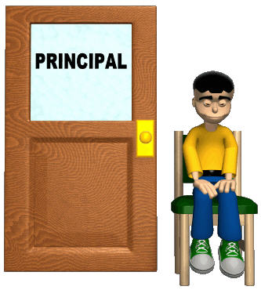
Determine
Verb
To set limits, to define
The principal will have to determine the best way to handle the problem.
Notes:
Input:
Have students to identify the part of speech, read the definition and the sentence.
Clarify/restate any information that is unclear or inaccurate.
Point out the suffix on the word
CFU:
Ask a student to give a paraphrase of the definition
Ask a different student to provide an example or another sentence using the word

Slide 6
finale
Noun
The last scene of a show or the last movement of a musical performance.
For the finale the orchestra played a concerto by Mozart.
Notes:
Input:
Have students to identify the part of speech, read the definition and the sentence.
Clarify/restate any information that is unclear or inaccurate.
Point out the suffix on the word
CFU:
Ask a student to give a paraphrase of the definition
Ask a different student to provide an example or another sentence using the word

Slide 7
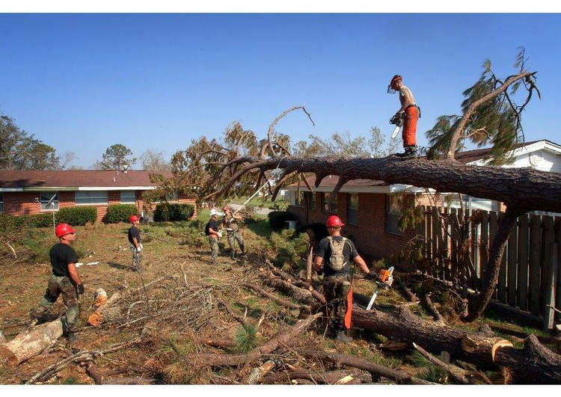
indeterminable
Adj
Cannot be determined or decided
The damage from the hurricane is indeterminable at this point.

Slide 8
infinite
adjective
Without limits; endless
Looking up at the night sky, it seemed like there were an infinite number of stars.
Notes:
Input:
Have students to identify the part of speech, read the definition and the sentence.
Clarify/restate any information that is unclear or inaccurate.
Point out the suffix on the word
CFU:
Ask a student to give a paraphrase of the definition
Ask a different student to provide an example or another sentence using the word

Slide 9
insatiable
Adjective
Unable to satisfy; greedy
My need to eat chocolate is sometimes insatiable.
Notes:
Input:
Have students to identify the part of speech, read the definition and the sentence.
Clarify/restate any information that is unclear or inaccurate.
Point out the suffix on the word
CFU:
Ask a student to give a paraphrase of the definition
Ask a different student to provide an example or another sentence using the word

Slide 10
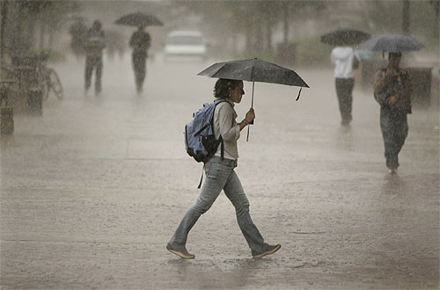
saturate
verb
To soak thoroughly; to fill fully
The rain saturated her clothes so she had to change when she got home.
Notes:
Input:
Have students to identify the part of speech, read the definition and the sentence.
Clarify/restate any information that is unclear or inaccurate.
Point out the suffix on the word
CFU:
Ask a student to give a paraphrase of the definition
Ask a different student to provide an example or another sentence using the word

Slide 11
terminable
adjective
Likely to end; can be ended
The agreement was terminable should either person decide to back out.
Notes:
Input:
Have students to identify the part of speech, read the definition and the sentence.
Clarify/restate any information that is unclear or inaccurate.
Point out the suffix on the word
CFU:
Ask a student to give a paraphrase of the definition
Ask a different student to provide an example or another sentence using the word

Slide 12
terminate
verb
To end; to close; to limit
I am going to terminate my e-mail account and just write letters.
Notes:
Input:
Have students to identify the part of speech, read the definition and the sentence.
Clarify/restate any information that is unclear or inaccurate.
Point out the suffix on the word
CFU:
Ask a student to give a paraphrase of the definition
Ask a different student to provide an example or another sentence using the word

Slide 13
Practice Using the New Words!
Notes:
The independent practice that goes with this lesson will be introduced with this slide. As it is modified, I will not present it on the PPT or SB as that may cause confusion for the students who have the unmodified version. However, the following is how I will review the worksheet with the whole class:
Input:
Read the directions for the first section.
CFU: Ask if there are any questions
Guided Practice/Modeling:
Read the two words listed for the first question.Ask if the two words have the same meaning or different meanings. Model looking up the meaning for construe – note that assume the meaning is part of the definition. Have a student say that the words have the same meaning. Have the students circle same. Tell them they will do the same for 2-8.
CFU: ask if there are questions
Input: read the directions for the second section
Guided Practice: read the word for #9. Explain that they are to determine the meaning of port and then add the meaning of er. Give the example of teach + er…someone who teaches. Say to do the same thing for port, but that someone who ports doesn’t make sense, so they will need to look at the MEANING for port…to carry from one palace to another. A porter is someone who carries things from one place to another. Have students write in answer. Tell them to do the remaining two questions the same way.
CFU ask for questions.
Input: read the directions for the third question.
G.P. Do the first one together. Have three different students name one thing that is portable. Have students write in the answers.
CFU ask for questions
IP: have students complete the worksheet independently. CFU: circulate. Monitor for correct answers. If time allows when students are finished, go over the answers as class.
Closure: Remind students to review the words during the week. Remind them that if they learn the root words they will add more than just those ten words to their vocabulary. Have students turn in worksheets to appropriate areas.

